Slide 1
Family History at the State Library of NSW
Notes:
Good afternoon, its nice to be here. My name is Renee McGann and this is Anne Raddacliffe. We’re Librarians in the Family History Team at the State Library of NSW. Today we’ll be taking you on a guided tour of our website because here you will find a lot of information relating to Family History, including some recent developments which you may not be aware of such as the digitisation of many resources unique to the Mitchell Library collections.
Firstly over to Ann to start our tour …

Slide 2
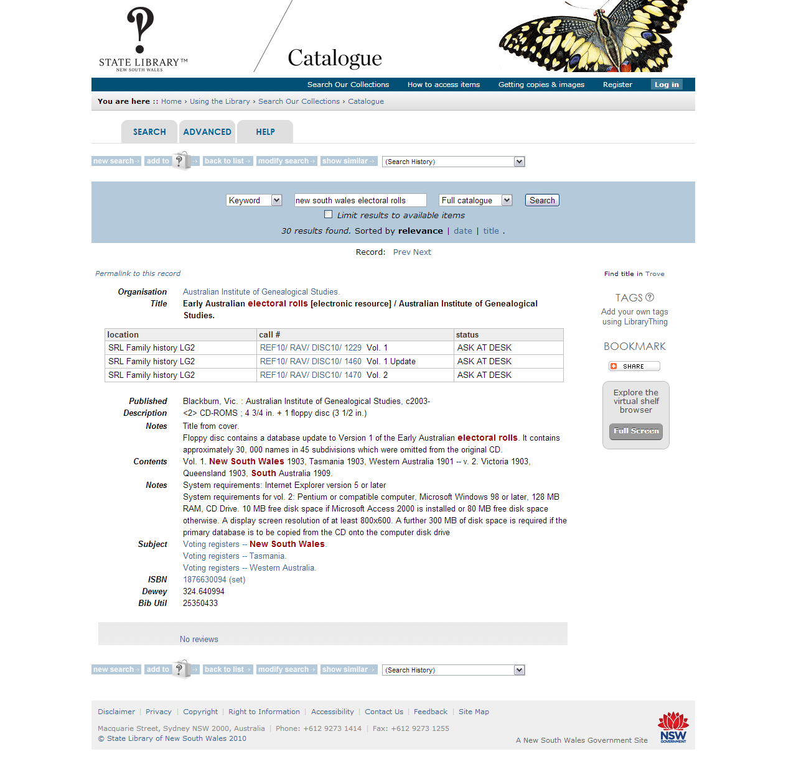
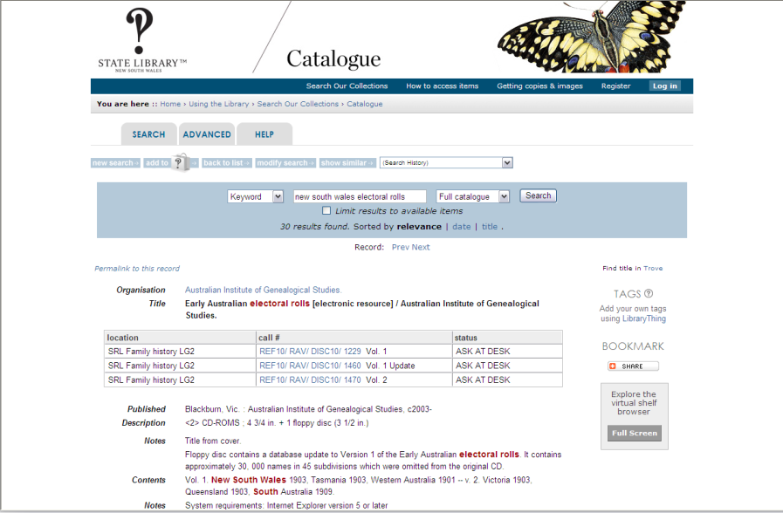
Notes:
The State Library has two online catalogues for our materials. There is one catalogue for published material and one catalogued for unpublished or original materials. The catalogue for published materials includes material in the State Reference Library and the Mitchell Library.

Slide 3
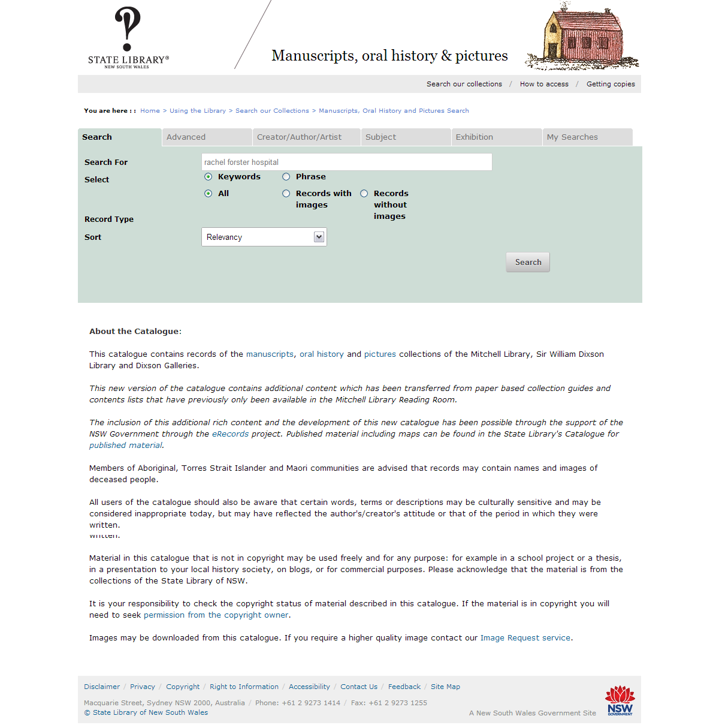
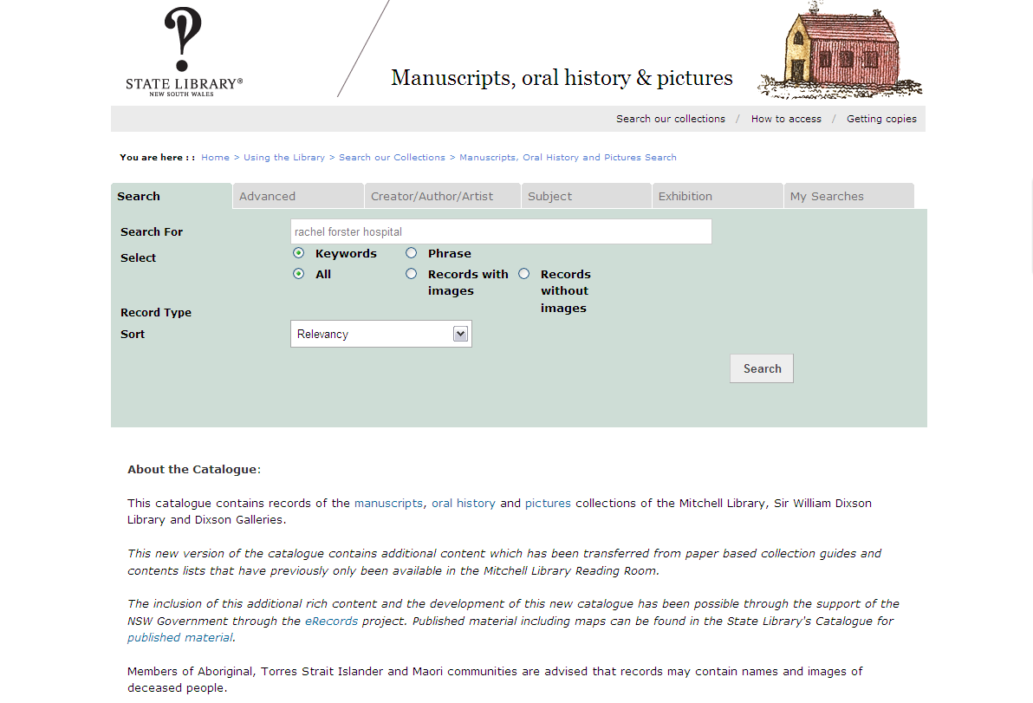
Notes:
The Manuscripts, oral history and pictures catalogue is for unpublished materials and therefore only includes items in the Mitchell Library. Unpublished materials include letters, diaries, photographs, sketches, paintings and oral history interviews all archived in the Mitchell Library. Renee will talk in more depth about the Mitchell Library’s collection.

Slide 4
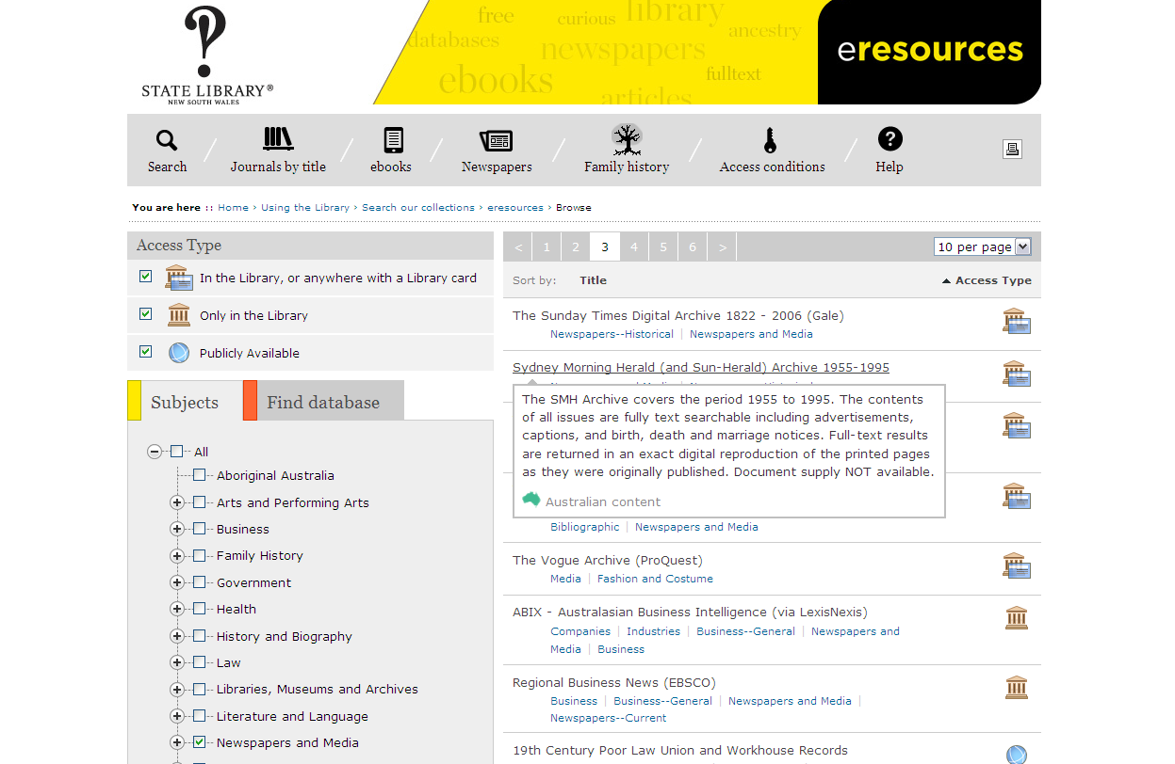
Notes:
Eresources is what we call our list of databases, CD ROMs and websites. They are organised by subject. There is a subject heading for Family History and also one for Newspapers. Under each subject heading you can search by topic eg. Census or Convicts.
The eresources have icons to let you know if the resource is available for access from home or if you need to be in the Library to use it. The icon of the Mitchell Library with the card over it means you can access the eresource from home. The icon of the Mitchell Library on its own means you can only access the eresource in the Library. The world icon refers to a publicly available website which can also be accessed from home.
The main FH databases we subscribe to are Ancestry Library and Find My Past. You must be in the Library to use them. However, most of our newspaper databases are available for access from home. These include the Sydney Morning Herald Archives, Gale NewsVault and the Times Digital Archive.

Slide 5
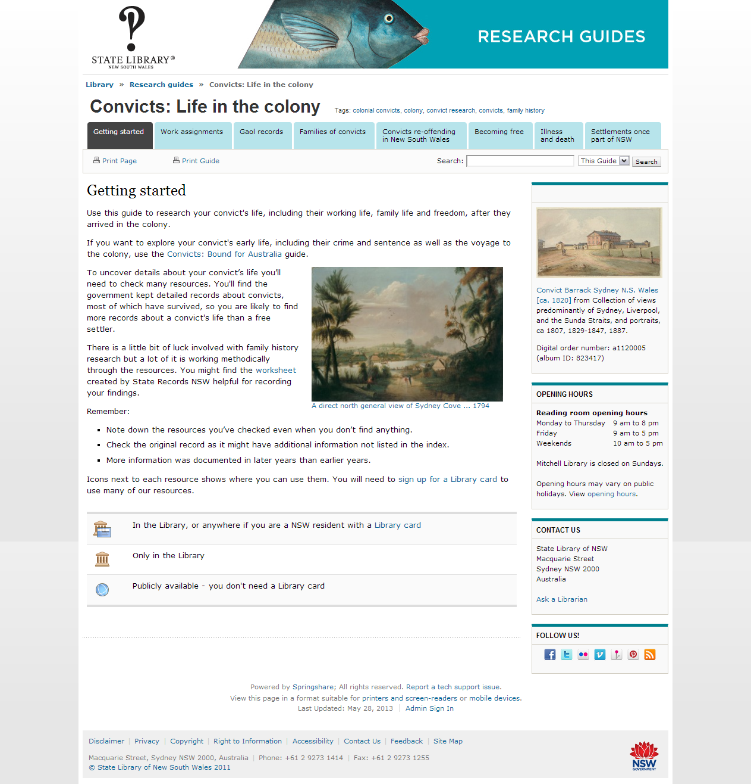
Notes:
We have also developed five Research Guides for Family History. There are two Guides for Convicts; one for Passengers records; one for shipping and one for Indigenous family history research. The Guides are designed to match family historians with resources at the State Library and online. Each guide has different topic areas and a list of resources below each topic heading (show Convict Guide: Life in the Colony). The icons for accessing resources are the same as those used in the eresources menu.
The Research Guides are a good tool for family historians who are starting their research. They are mostly aimed at people researching ancestors who lived in New South Wales. We also use the Research Guides as a training resource for staff who are new to working in Family History. We promote them to public libraries and local historical societies.

Slide 6
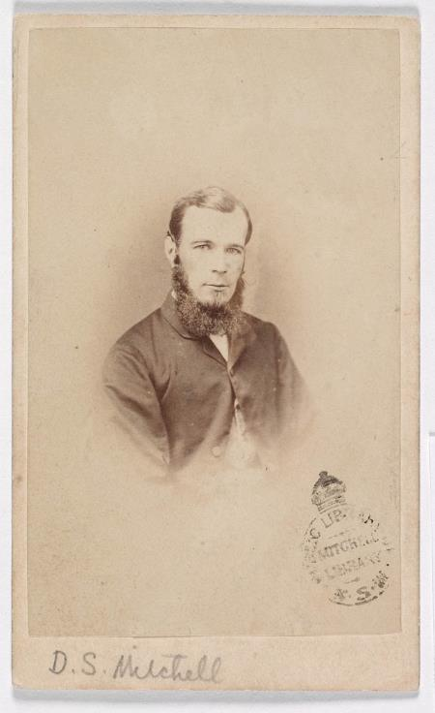
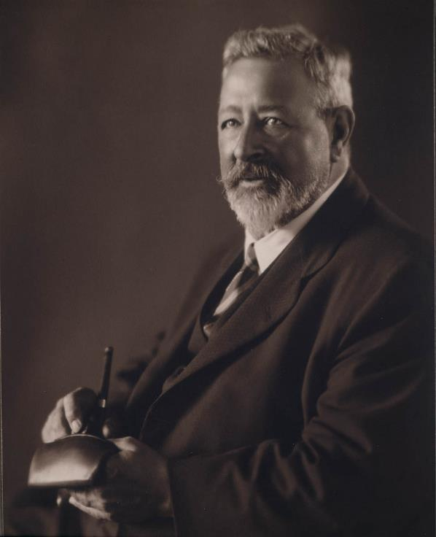
Benefactors David Scott Mitchell and Sir William Dixon
Notes:
Renee: Firstly a bit about the Library’s two most important benefactors:
David Scott Mitchell (1836-1907) bequeathed a collection of 40,000 books, manuscripts, maps and pictures as well as an endowment of 70,000 pounds to the Library in 1907.
With book collecting as an interest, his aim was to collect a copy of every document he could related to Australia and the Pacific. He was very focused.
He also had a lot of money and a growing reputation, so book dealers would alert him to rarities.
At the same time he was collecting many records were being destroyed to cover up the convict ‘stain’.
In response to this Mitchell is quoted as saying prophetically:
“ The main thing is to get the records. We’re too near our own past to view it properly, but in a few generations the convict past will take its proper place and our historians will pay better attention to the pioneers”.
Mitchell recognised the need to collect the records of our unique heritage.
The Mitchell Library, under the copyright act, is a legal deposit library for all material published in NSW
Sir William Dixon (1870-1952) was a businessman and collector of Australiana, and a great benefactor.
Bequeathing a magnificent collection of pictures, books, map, manuscripts, tokens, coins, and medals.
He was one of the most generous benefactors of twentieth century Australia ; donating over 20,000 items.
Of note was Dixson’s collection of paintings; among them a portrait of explorer Charles Sturt in 1914 ; and in 1919 he offered a collection of historical pictures which became the Dixson Galleries .
While he loved collecting, he also loved to give his collection away. He started buying material simply to pass it on to the Library ; Joseph Lycett’s magnificent painting Corroboree at Newcastle was bought and donated by Dixson

Slide 7
Digital Excellence
Notes:
R: Now to some of the recent developments ….. The State Library has launched two major projects to digitize collections which will provide world-wide access to our nation’s most iconic and historically significant collections.
From a family history perspective one can get an idea of what life was like during the time your ancestor lived
The Library’s collections make up the world’s foremost archive on European exploration and settlement of Australia, and the Indigenous people. With over 5.5 million items – photographs, manuscripts, books, maps, pictures, oral histories, newspapers and artefacts – the collections continue to grow as we document life in NSW and Australia’s modern story.
The State Government will contribute around $32 million over the next four years to help fast track the Library’s major digitisation program and to upgrade its digital infrastructure.
R: HERE ARE SOME EXAMPLES ….. Subdivision plan for a Land Sale at Maroubra 1910 … a great resource for family and local history these were produced by real estate agents to publicise land for sale . AND 2. King Buncaree, Chief of the Broken Bay tribe, with his breast plate in 1832

Slide 8
World War One Diaries Partridge Diary 1914-1917
Notes:
R: World War One Diaries … The Library has approximately 1000 of the diaries. They relay the experiences of the NSW soldiers fighting in the war.
Even if your ancestor was not included in this collection they may have been in a particular battle or regiment and the experiences would have been the same as relayed in the Diary.
All the diaries have been transcribed by volunteers to make them easier to read.
To complement this collection we have a large number of portraits of WW1 soldiers “soldiers world war 1” There are 1668 individual records for servicemen

Slide 9
Notes:
All the diaries have been transcribed by volunteers which means they will be easier to read.
To complement this collection we have a large number of portraits of WW1 soldiers “soldiers world war 1”

Slide 10
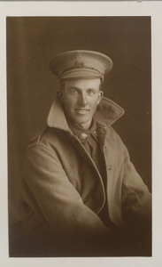
Portraits of Soldiers Australian Imperial Force (A.I.F.)
Notes:
Portraits of Soldiers
R. The Trustees of the Mitchell Library undertook to collect these portraits of soldiers in the AIF. Relatives of soldiers were asked to forward photographs to the Crown Studios, Sydney for copying.

Slide 11
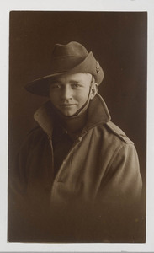
Portraits of Soldiers
Notes:
Most of the portraits are of soldiers who enlisted in 1918

Slide 12
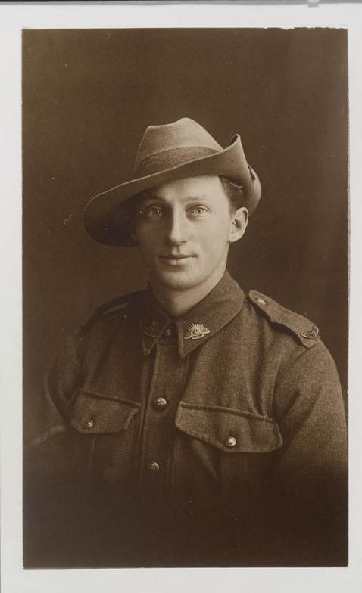
Portraits of Soldiers
Notes:
From the online catalogue you can navigate to a detailed description of each portrait.

Slide 13
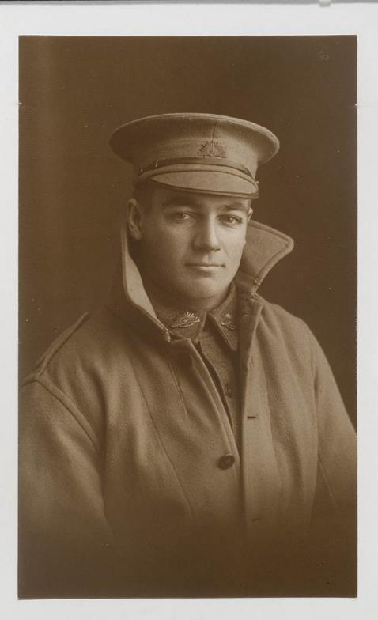
Portraits of Soldiers
Notes:
The information found on these records is name, date of birth, enlistment date, trade or calling, birthplace, address prior to enlistment, rank, number and distinctions, casualties, next of kin and father’s name on the back of the photograph
They’re a great source of information for those who have a service man in their family

Slide 14
First Fleet Journal
Notes:
R: Now to the First Fleet Journals …. The Library holds 9 of 11 known First Fleet Journals in existence.
They are written by midshipmen and surgeons who sailed on the First Fleet.

Slide 15
First Fleet Journal
Notes:
The Journals give a visual image of conditions on the ship, the voyage, weather, landscape, nature.
Some include personal letters to relatives in England.

Slide 16
Names of Convicts on Board the Lady Penryhn
Notes:
One example is the journal kept by Arthur Bowes Smyth who sailed with the First Fleet as Surgeon on board the Lady Penrhyn.
His journal includes the names of women convicts on board , also the names of children born on the ship during the voyage
Here is a list of convict names

Slide 17
Notes:
R: Here is a letter written by George Worgan to his brother Richard in 1788 while on the First Fleet ship the HMS Sirius.

Slide 18
Transcript of a1175003
Sirius, Sydney Cove, Port Jackson - June 12M 1788. De/ur Richard. I think I hear You saying, "Where the D—ce is Sydney Cove Port Jackson"? and see You whirling the Letter about to find out the the Name of the Scribe: Perhaps You have taken up Salmons Gazetteer, if so, pray spare your Labour, and attend to Me for half an Hour - We sailed from the Cape of Good Hope on the 12th of November 1787- As that was the last civilized Country We should touch at, in our Passage to Botany Bay We provided ourselves with every Article, necessary for the forming a civilized Colony, Live Stock, consisting of Bulls, Cows, Horses Mares, Colts, Sheep, Hogs, Goats Fowls and other living Creatures by Pairs. We likewise, procured a vast Number of Plants, Seeds & other Garden articles, such, as Orange, Lime, Lemon, Quince Apple, Pear Trees, in a Word, every Vegetable Production that the Cape afforded. Thus Equipped, each Ship like another Noah's Ark, away we steered for Botany Bay, and after a tolerably pleasant Voyage of 10 Weeks & 2 Days Governour Phillip, had the Satisfaction to see the whole of his little …
Notes:
And here is part of the transcript detailing the ships cargo including the animals and plant life they brought out
All the journals have a transcript.
This work is done by the Library’s volunteers

Slide 19
Shipboard Newspapers
Notes:
R: Shipboard newspapers …. These were printed or written on the voyages from England to Australia.
They frequently included illustrations, caricatures, passenger lists, poetry, letters to the editor, local news. The papers contained the names of people, they were all about life on the ship including , the time prayers started and marriages, deaths and births.

Slide 20
The Petrel Papers
Notes:
Another example is "The Petrel Papers" a weekly journal from the ship 'Parramatta'.
The 'Parramatta' departed London 7 Oct. 1882 and arrived at Sydney on 3 Jan. 1883 under Captain Goddard. The journals contain contributions from passengers and crew including reports of shipboard activities and entertainments; details of the ship's progress including latitude, longitude, distances, temperature and barometer readings; verse and stories written by passengers.

Slide 21
Early Photographs The Holtermann Collection
Notes:
The Holtermann Collection …. In 1951 a hoard of 3,500 glass plate negatives from the nineteenth century was discovered in a shed at Chatswood.
This find turned out to be the most important photographic documentation of the goldfields in Australia.
The photographers responsible for the images were Merlin and Bayliss

Slide 22
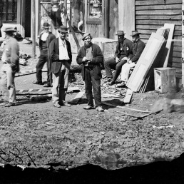
Hill End
Notes:
Next slide: Their wet plate negatives captured exceptional detail, but copies made in the twentieth century failed to reveal the wealth of information hidden within. In 2008, plans were made to digitally scan the Holtermann Collection at very high resolution.
For the first time in 140 years, it is possible to see what Merlin and Bayliss photographed, with astonishing clarity and fidelity.

Slide 23
Gold Specimens, 1872
Notes:
Next slide: In an extraordinary act of patronage, the newly rich Holtermann used some of his wealth to employ Merlin and Bayliss to photograph the gold producing areas in NSW and Victoria for exhibition overseas.
Proud of his own success, he believed that his travelling exposition would encourage immigration to Australia.

Slide 24
The Holtermann nugget, Hill End
Notes:
Next slide: The Holtermann nugget …. In 1872, the world’s largest specimen of gold, known as the Holtermann Nugget was unearthed at Hawkins Hill, near Hill End and Merlin and Bayliss were there to record it. Perhaps the largest specimen of gold ever found it was 1.5 meters long, weighing 286 kg and had an estimated gold content of 3000 ounces.

Slide 25
Mrs. Holtermann with house, Hill End
Notes:
Next slide: Here is a photo of Mrs Holtermann out the front of their house

